Slide 1
Dr. Pepper Snapple Group: Rate the Rate
By Haichen Liu and Clay Moore

Slide 2
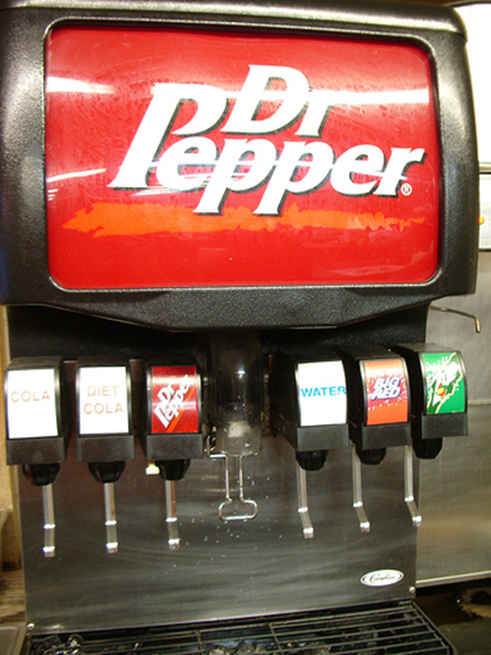
Background
Fountain Food Service(FFS) represents the segment of business where product is poured out of a fountain(typically found in restaurants, convenience chains, etc.)
The customer segment assignments are subjective, and have not been changed in over 5 years.

Slide 3

Background
Dr. Pepper has a financial model for how they sell their product
Fountain Food Service
Sell concentrate to put into the machine
Follows a certain model to give prices
Asked for our help to see if the model could be improved
https://s-media-cache-ak0.pinimg.com/236x/60/0f/dc/600fdc3e57ec033878f3a0beca110435.jpg

Slide 4
Problem
Are there inconsistencies in the current financial model?
Does FFS’s past pricing/discount decisions imply that should segment our business going forward?
Is the current customer segmentation being used today the same way we want to segment our customers tomorrow?

Slide 5
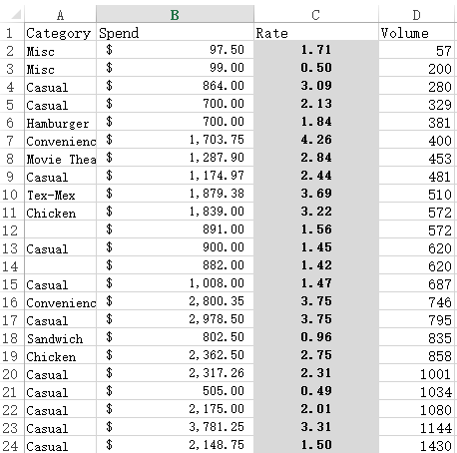
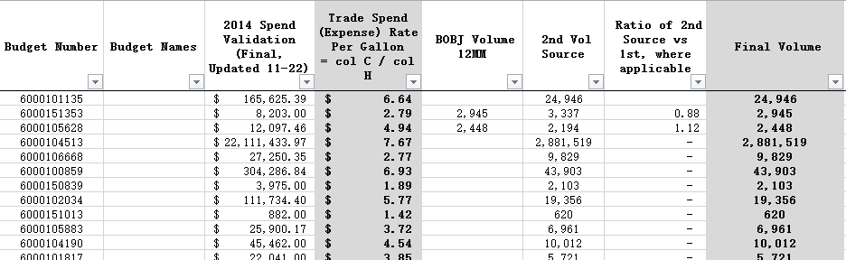
Data

Slide 6
Steps
Random Sampling
Investigating what they believe
Can we improve the model?
Confidential agreements

Slide 7
Sampling
Given over 1250 accounts across the United States
Too much sensitive information to extract all the data we needed
Needed to create a representative sample of the population
Selected 125 accounts using a random number generator in Excel
Returned 110 accounts
Confidence level = 73%
Wanted to see if there was any similarity
Limited man hours

Slide 8
Variables
Expense
How much the total order cost
Volume
How big the order was (gallons)
Rate (per gallon)
Expense divided by Volume

Slide 9
Current Financial Model
Rate per Gallon given based on size of business and type of business
Business that generates a ton of revenue = high level
Higher level = higher rate
Pizza based restaurant has a higher rate than a gas station

Slide 10
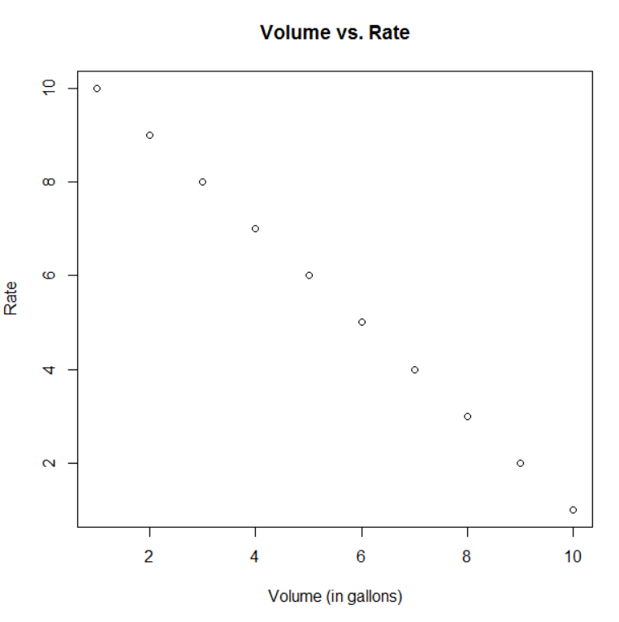
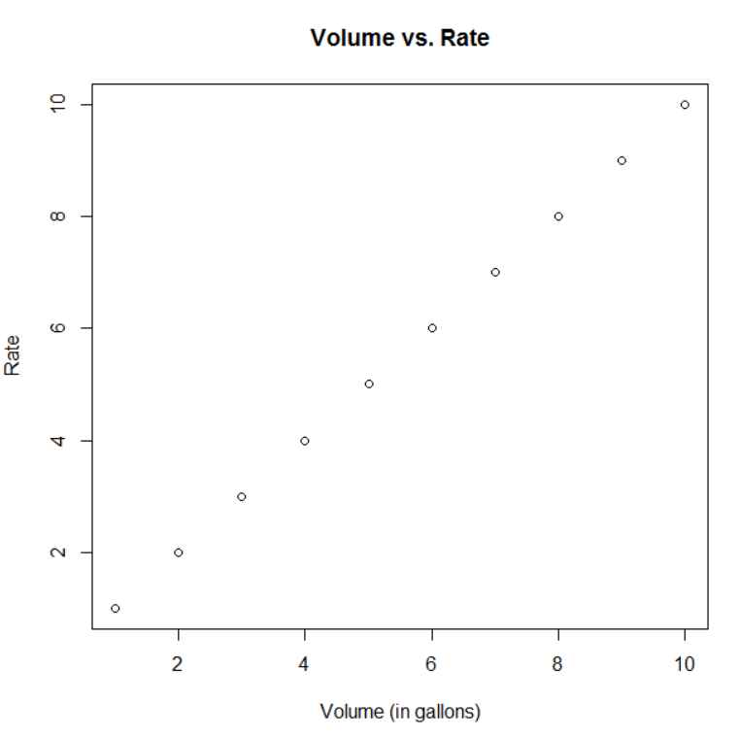
Ideal Situation

Slide 11
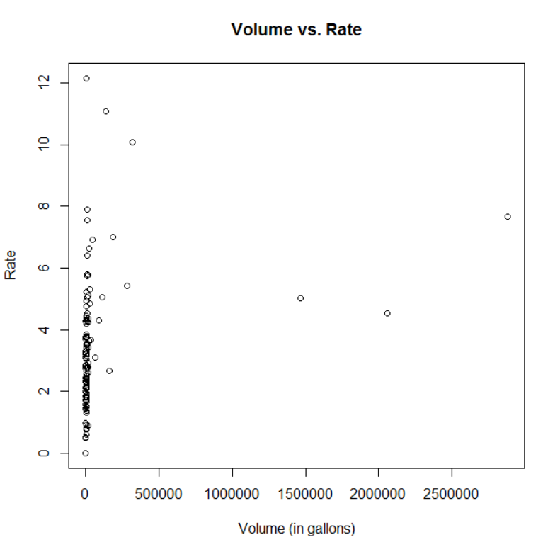
Investigating the data
Not what DPSG wanted to see
Rate should be lower for higher volumes
Initial response
Base their cost on how much they spend
Do their business based on establishment
Make more profit if they do by volume

Slide 12
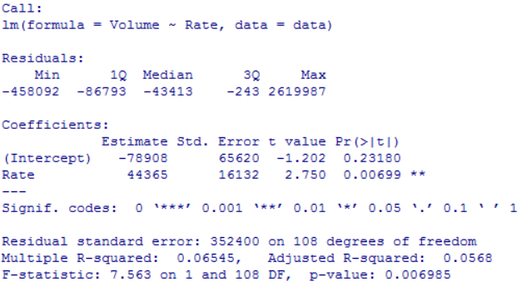
Model interpretation
Initial response of model
Both Rate and Intercept are statistically significant
Statistical significance set at 0.27
R² is 0.06545
Model does not fit well.

Slide 13
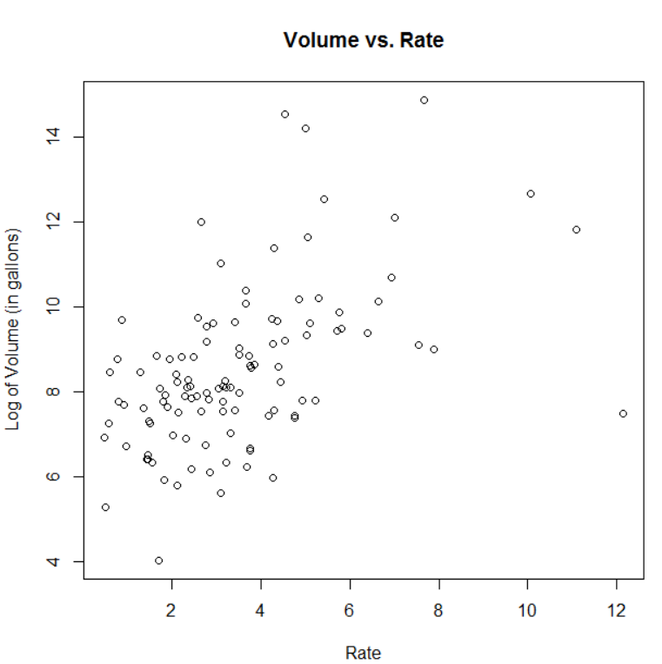
Investigating the data
Take the log of Volume to get a better picture of the scatterplot
Still pretty sporatic
Does have a general upward trend

Slide 14
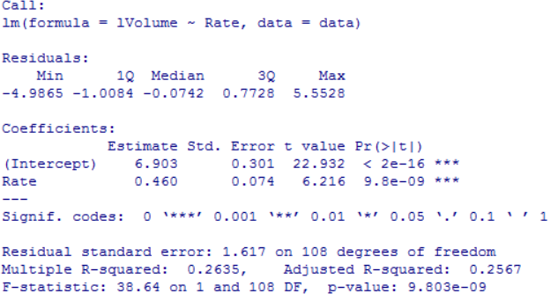
Model interpretation
Initial response of model
Both Rate and Intercept are statistically significant
R² is 0.2635
Model does not fit well.

Slide 15
What to do?
Create a new model to be analyzed
Based the discount rate off of how much volume is sold
Do not base model off of customer type

Slide 16
Our model
Create a rate that feeds off of the volume
Category 1: 0 – 1,000
Category 2: 1,001-5,000
Category 3: 5,001-10,000
Category 4: 10,001 – 50,000
Category 5: 50,001 – 500,000
Category 6: Over 1,000,000

Slide 17
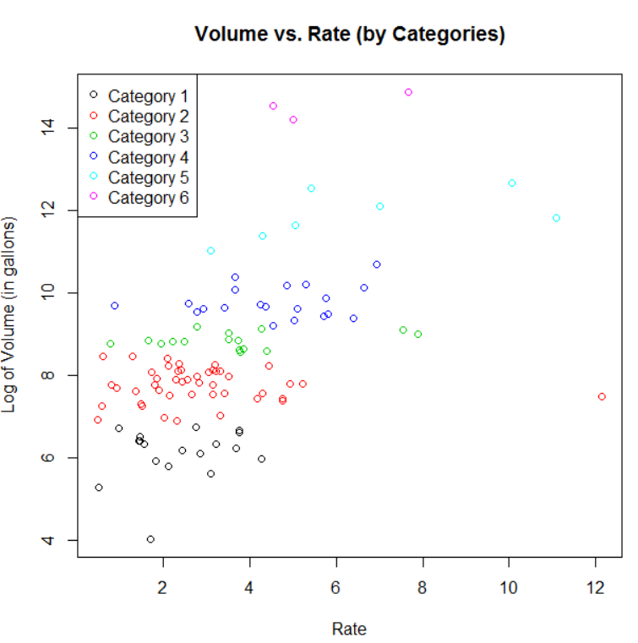
Plot by Category

Slide 18
Conclusion
Results are conclusive and inconclusive
Conclusive:
The rate is not affected by the volume
Should change the financial model to reflect “bulk buying” theory
Inconclusive:
What to change the rates to

